Slide 1
Advanced Geospatial Data Analytics: Pig and Python on Hadoop
Junjun Yin
CyberGIS Center for Advanced Digital and Spatial Studies
Department of Geography and Geographic Information Science
National Center for Supercomputing Applications (NCSA)
University of Illinois at Urbana-Champaign, IL, 61801
jyn@illinois.edu
March 1st, 2016

Slide 2
Exploring data with Pig: Advanced data operations
Notes:
Pig was created at Yahoo. To make it easier to analyze the data in your HDFS without the complexities of writing a traditional Mapreduce program.
Pig abstract away these complexities.
Internally it creates a sequence of MapReduce jobs,

Slide 3
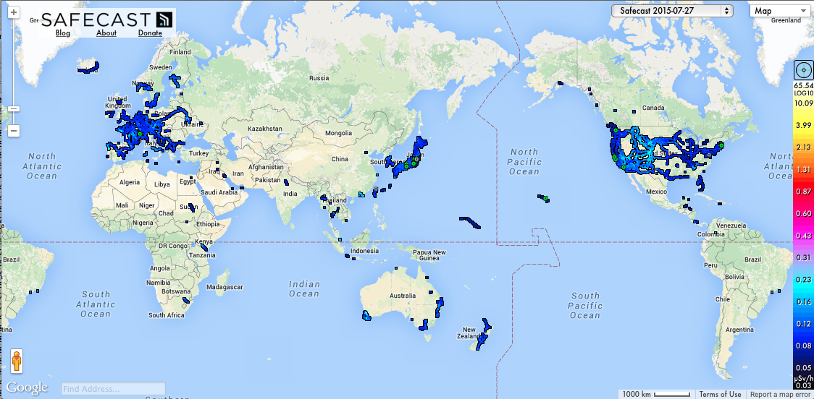
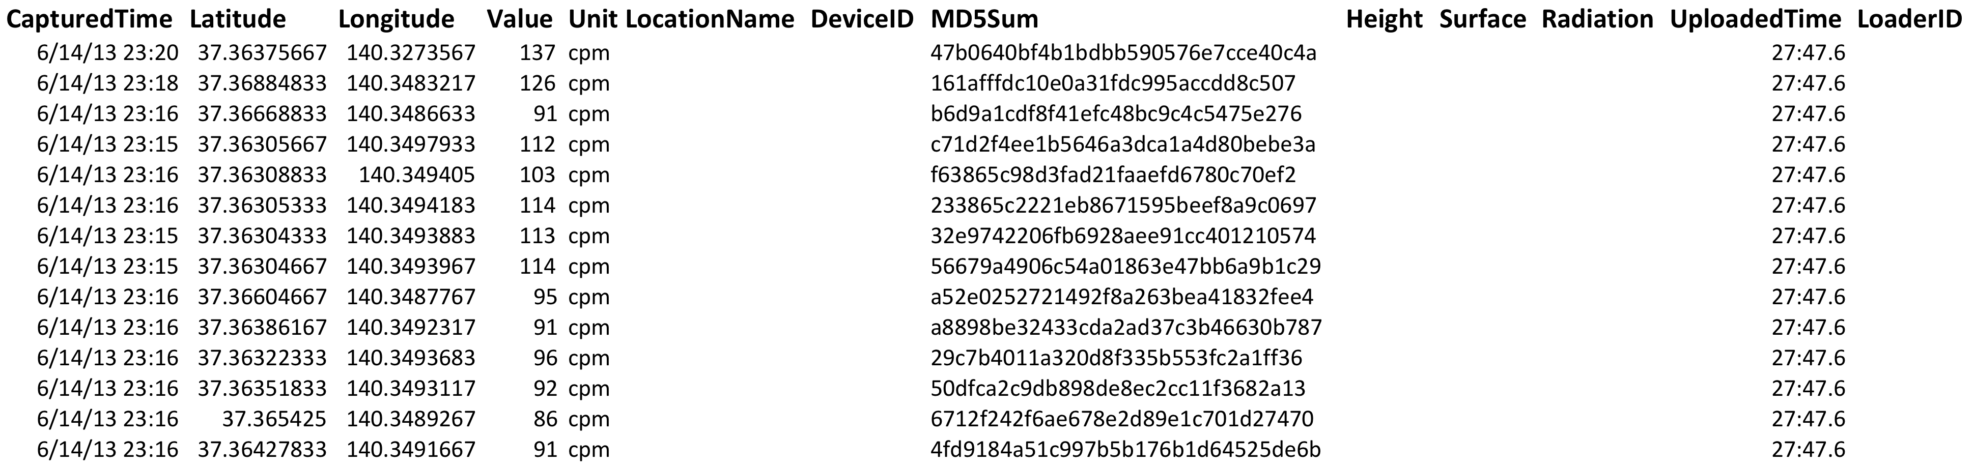
Dataset: Safecast dataset
Safecast -- http://blog.safecast.org

Slide 4
Making a heatmap based on radiation dataset
Objective:
We had implemented a heatmap (or density map) of New York taxi data with Python and Hadoop Streaming API.
Use Pig to navigate through HDFS and explore a different dataset, with the same approach but easier implementation.
If you want to get your hands on the illustrations:
The materials (data and scripts) are stored in /gpfs_scratch/geog479/lecture7

Slide 5
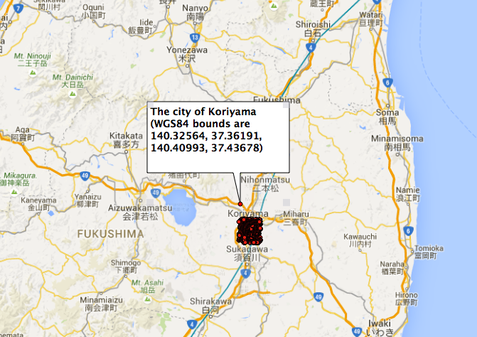

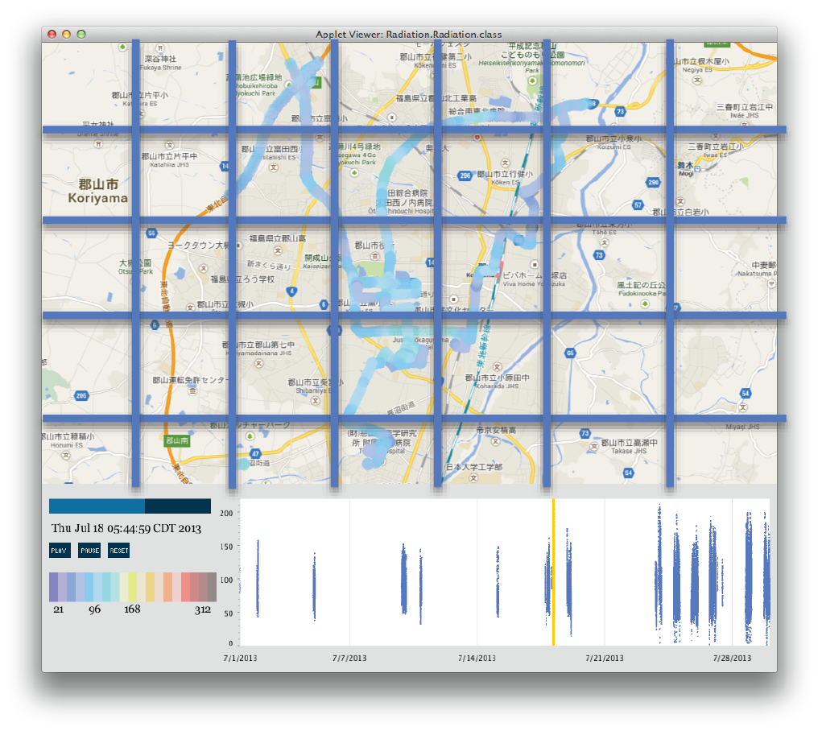
The city of Koriyama, Japan
((0,0), 120.97 cpm)
((0,1), 93.77 cpm)
((0,2), 108.32 cpm)
((0,3), 101.45 cpm)
((0,4), 112.87 cpm)
((0,5), 98.45 cpm)
((0,6), 119.32 cpm)
((0,7), 121.21 cpm)
…
Notes:
Putting a file into HDFS involves the following steps:

Slide 6
Making a heatmap data with Pig
Start the Grunt Shell.
$ pig
Load the radiation.csv data in HDFS.
$ raw = LOAD 'radiation.csv' USING PigStorage(',') AS (CapturedTime : chararray,Latitude:double,Longitude:double,Value:int,Unit:chararray);
Step 1: Filter out CaptureTime.
$ step1 = FILTER raw BY CapturedTime is not null AND CapturedTime != 'null' AND CapturedTime != '';
Step 2: select the rows of which unit is cpm.
$ step2 = FILTER step1 BY $4 MATCHES 'cpm';
Step 3: Filter out the data based on the bounding box of Koriyama, Japan.
$ step3 = FILTER step2 BY $2 > 140.32564 AND $2 < 140.40993 AND $1 > 37.36191 AND $1 < 37.43678;
Notes:
Change hadoop duplication factor:
hadoop fs –setrep –w 3 /my/file
hadoop fs –setrep –w 3 -R /my/dir

Slide 7
Making a heatmap matrix
Step 4: Select the rows of which CapturedTime is August.
$ step4 = FILTER step3 BY ($0 > '2013-08-01 00:00:00' AND $0 < '2013-09-01 00:00:00');
Step 5: Generate new records to send down the pipeline to the next operator.
$ step5 = FOREACH step4 GENERATE $0,$1,$2,$3,$4;
Step 6: Generate new records based on latitude and longitude key.
$ step6 = FOREACH step5 GENERATE $3,(int)(($2 - 140.32564)/0.005) AS logkey,(int)(($1 - 37.36191)/0.005) AS latkey;
Step 7: Collect all records with the same latitude and longitude key.
$ step6_group = GROUP step6 BY (latkey,logkey);

Slide 8
Making a heatmap matrix
Step 8: Calculate the average of radiation levels per each cell.
$ step6_avg = FOREACH step6_group GENERATE group, AVG(step6.Value);
Step 9: Sort data based on the group.
$ result = ORDER step6_avg BY group;
Step 10: Send the output to a folder in HDFS.
$ Store result into 'heatmap_output';
Step 11: Log out the Grunt shell
$ quit
Step 12: Verify the file is in HDFS by listing the contents of heatmap_output
$ hdfs dfs -ls heatmap_output;

Slide 9
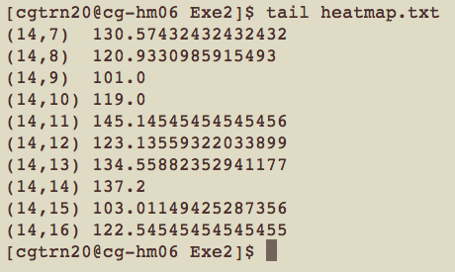
Making a heatmap
Step 12: Take a source directory as input and concatenate files into the destination local file
$ hdfs dfs -getmerge heatmap_output heatmap.txt
Step 13: Explore the data format in the output file
$ tail heatmap.txt
What does it remind you of ?

Slide 10
Quiz
True or False: Field names and relation names are case sensitive in your Pig Latin scripts. However, Pig Latin key words are not case sensitive.
Pig has three complex types: ( ), ( ), and ( )
True or False: The steps in the logical plan do not actually execute until a DUMP or STORE command.
Notes:
Putting a file into HDFS involves the following steps:
Sensitive
Map, tuple and bag
Currently, it is true

Slide 11
Analyzing data with Python: Pig UDP with Python Hadoop Streaming API with Python for geospatial operations
Notes:
Python is a programming language:
High level, Human readable, Interpreted, Highly extensible with a large collection of libraries variables.
We assume you are already familiar with Python. If not, it doesn’t matter, we will not implement Python codes. Just call Python code from Pig on Hadoop cluster.

Slide 12
Python
Python is an interpreted, interactive, object-oriented programming language¹.
Python as Glue
Part of Python’s success as a scientific computing platform is the easy of integrating a set of legacy C, C++, and FORTRAN code.
Solving the “Two-Language” Problem
Python is a suitable language not only for doing research and prototyping but also building the production systems.
Limitation of Python
Python code will run substantially slower than code written in a compiled language like Java or C++.
Python is not an ideal language for highly concurrent, multithreaded applications, particularly applications with many CPU-bound threads.
1. McKinney, W. (2012). Python for data analysis “O'Reilly Media, Inc.".
Notes:
It incorporates modules, exceptions, dynamic typing, very high-level dynamic data types, and classes.
It combines remarkable power with very clear syntax.
It has interfaces to many system calls and libraries, as well as to various window systems, and is extensible in C or C++
It is also usable and an extension language for applications that need a programmable interface.
It is portable and runs on many Unix variants, on the Mac, and on Windows 2000 and later.
Python is a loosely typed programming language.
it is common to research, prototype, and test new ideas using a more domain-specific computing language like MATLAB or R then later port those ideas to be part of a larger production system written in, say, Java, C#, or C++
This is not to say that Python cannot execute truly multithreaded, parallel code; that code just cannot be executed in a single Python process. As an example, the Cython project features easy integration with OpenMP, a C framework for parallel computing, in order to to parallelize loops and thus significantly speed up numerical algorithms.

Slide 13

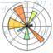

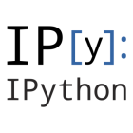


The Scientific Python Ecosystem
The Python ecosystem has an impressive collection of libraries in mathematics, statistics, data analysis and machine learning.
Numpy: The foundational package for scientific computing
SciPy: A collection of mathematical algorithms and functions
matplotlib: 2D and 3D plotting library
Sympy: Symbolic mathematics
IPython: Enhanced interactive console
Pandas: Data structures and analysis
Notes:
It incorporates modules, exceptions, dynamic typing, very high-level dynamic data types, and classes.
It combines remarkable power with very clear syntax.
It has interfaces to many system calls and libraries, as well as to various window systems, and is extensible in C or C++
It is also usable and an extension language for applications that need a programmable interface.
It is portable and runs on many Unix variants, on the Mac, and on Windows 2000 and later.
Python is a loosely typed programming language.
it is common to research, prototype, and test new ideas using a more domain-specific computing language like MATLAB or R then later port those ideas to be part of a larger production system written in, say, Java, C#, or C++
This is not to say that Python cannot execute truly multithreaded, parallel code; that code just cannot be executed in a single Python process. As an example, the Cython project features easy integration with OpenMP, a C framework for parallel computing, in order to to parallelize loops and thus significantly speed up numerical algorithms.

Slide 14
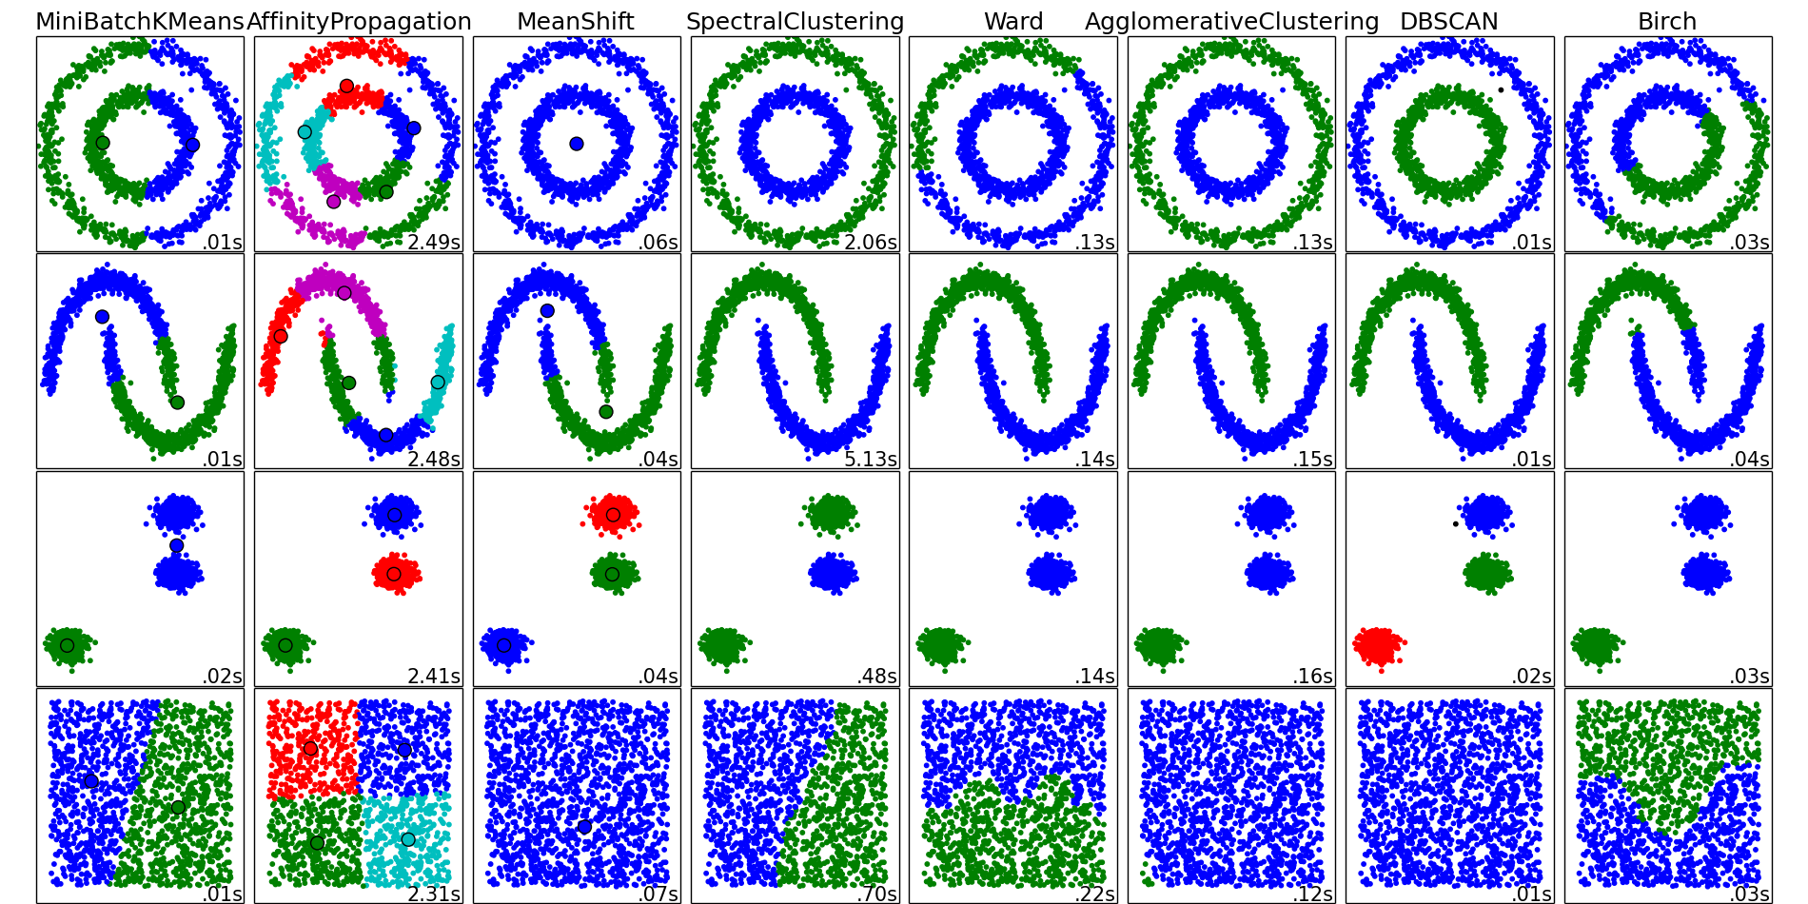
Scikit-learn machine learning in Python
An open-source machine learning library for Python¹
Simple and efficient tools for data mining and data analysis
Build on NumPy, SciPy and matplotlib
1. http://scikit-learn.org/stable/index.html#
Notes:
It incorporates modules, exceptions, dynamic typing, very high-level dynamic data types, and classes.
It combines remarkable power with very clear syntax.
It has interfaces to many system calls and libraries, as well as to various window systems, and is extensible in C or C++
It is also usable and an extension language for applications that need a programmable interface.
It is portable and runs on many Unix variants, on the Mac, and on Windows 2000 and later.
Python is a loosely typed programming language.
it is common to research, prototype, and test new ideas using a more domain-specific computing language like MATLAB or R then later port those ideas to be part of a larger production system written in, say, Java, C#, or C++
This is not to say that Python cannot execute truly multithreaded, parallel code; that code just cannot be executed in a single Python process. As an example, the Cython project features easy integration with OpenMP, a C framework for parallel computing, in order to to parallelize loops and thus significantly speed up numerical algorithms.

Slide 15
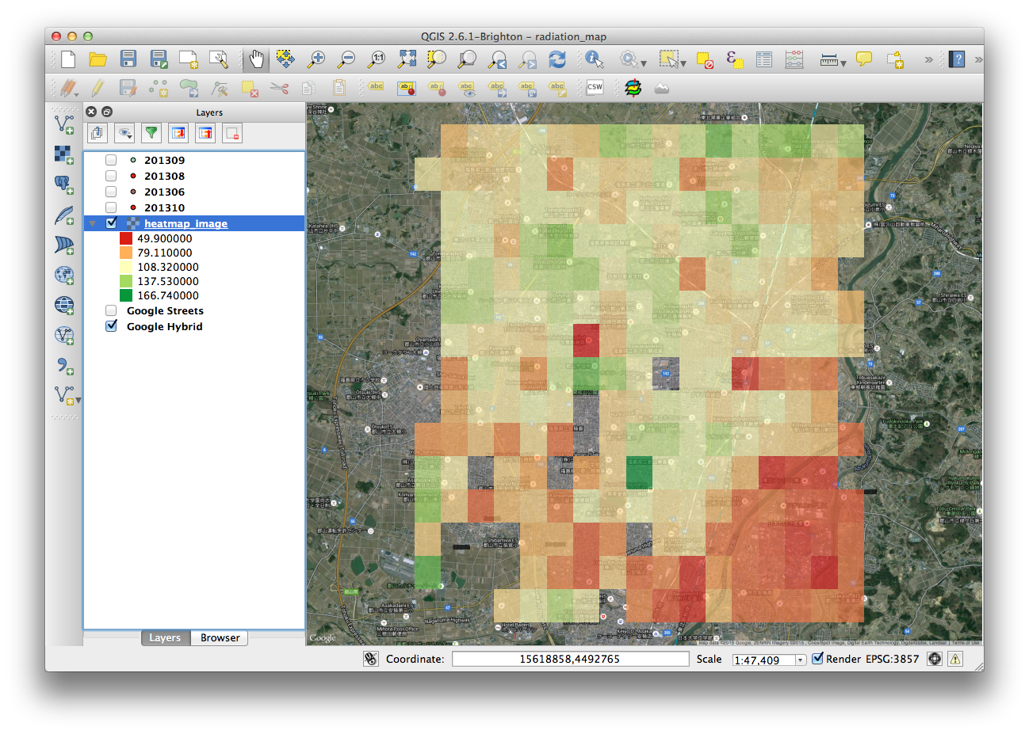
Generating a heatmap image using Pig with Python
Objective:
Make a heatmap image file (Ascii format) based on the previously generated text file in Exercise 2.

Slide 16
Running Python on Hadoop
In general, there are two ways to use Python on Hadoop
Hadoop Streaming API (as a delegation)
As an external script language being executed by programs on Hadoop (e.g., Pig, bash, etc.) (as a second delegation)
Notes:
How to run Python on Hadoop.
I guess some of you have already python codes for your own work. Now you want to know how to run these python codes in hadoop cluster.
This unit will discuss two options for running Python on Hadoop

Slide 17
Pig User Defined Functions (UDFs)
Alternatives to Hadoop streaming for running Python on a cluster
Pig User Defined Functions (UDFs): Invoking Python code from within a Pig script
Pig Streaming: Using the Pig STREAM command
Combine Pig’s operators with their own or others’ code via UDFs
Pig provides extensive support for user defined functions (UDFs) as a way to specify custom processing
Java
Jython: a Python implementation that runs on a JVM
Python (Python UDFs do not work on Hadoop 2.x)
Javascript, Ruby and Groovy (experimental)
Notes:
Hadoop streaming allows mappers and reducers to be written in any programming language.
you must translate your Python code using Jython into a Java jar file. Obviously, this is not very convenient and can even be problematic if you depend on Python features not provided by Jython

Slide 18
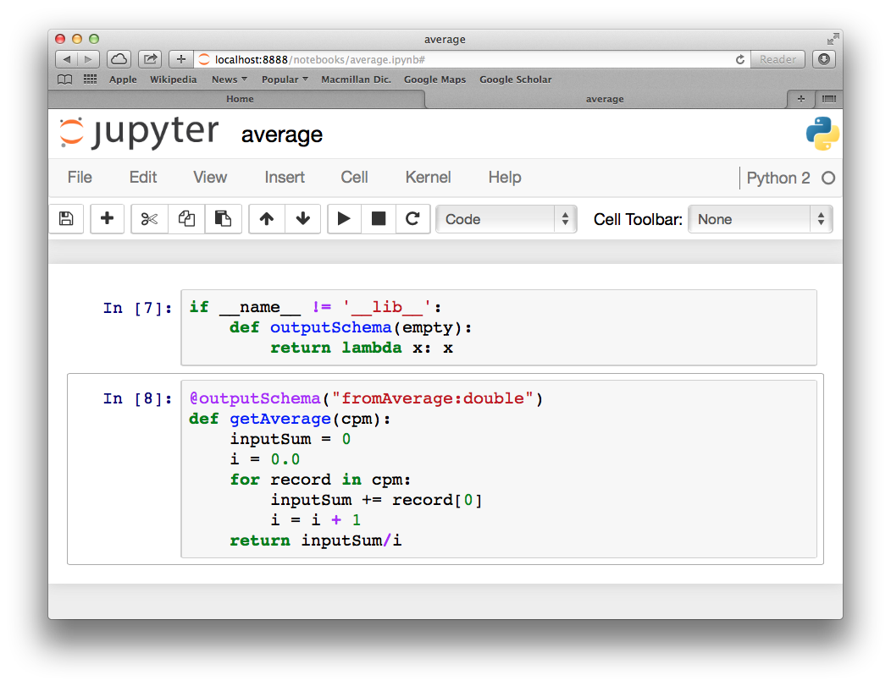
Writing a Pig UDF in Python
A UDF written in Python can be any Python function.
Annotate the function using @outputSchema so Pig can determine what the data type of the return value is.
Notes:
When developing UDFs
In Python,
you
need
to
include
the
@outputSchema
annotation,
which
causes
a
compiler
error
because
Python
tries
to
locate
the
outputSchema
function
and
it
is
not
something
that
can
be
imported.
(It
is
only
used
by
Pig.)
To
avoid
this
issue,
you
can
simply
define
outputSchema
to
be
a
no-°©‐op
function
in
your
Python
script
–
very
useful
for
development
and
testing:

Slide 19
Invoking a UDF
Before invoking a Python UDF, we need to register the text file that contains the function definition.
register 'udfs.py' using jython as udfs;
A = LOAD ‘work’ AS (department:chararray,name:chararray,salary:double);
B = GROUP A BY department;
C = FOREACH B GENERATE group, udfs.getAverage(A.Value) ;
By incorporating the UDF in the Pig script, we can take advantage of Pig’s ability to manipulate and group our big data, while also taking advantage of Python’s powerful but simple processing and logic.

Slide 20
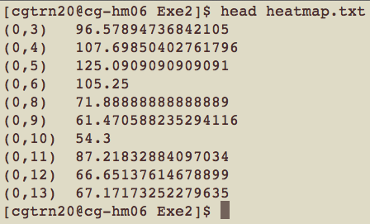
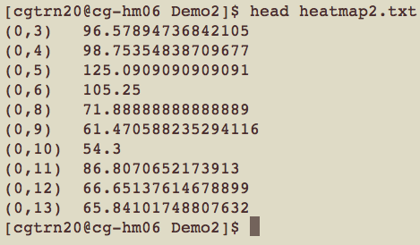
Demo 2: Generating a heatmap after removing outliers using Pig UDF
Objective:
Make a heatmap image file (Ascii format) after removing outliers per each cell.
Compare the result with that of Exercise 2.

Slide 21
Generating a heatmap after removing outliers using Pig UDF
Boxplot of radiation levels split by month at the city of Koriyama, Japan in 2013.

Slide 22
Pig STREAM Command
Pig streaming is a different implementation of Hadoop streaming.
The behavior is similar, but with Pig streaming you get the advantage of being able to manipulate and group the data before running it through the Python script.
Notes:
Pig Stream command sends data to an external script or program.

Slide 23
Pig STREAM Command
The Pig STREAM command sends data to an external script or program. The syntax looks like:
alias = STREAM alias [, alias …] THROUGH {`command` | cmd_alias} [AS schema] ;
E.g., x = LOAD ’311_data';
result = STREAM x THROUGH `kmeans`;
Defining a streaming alias
Use the DEFINE command to assign an alias to a streaming command.
DEFINE kmeans `kmeans311.py` SHIP (‘kmeans311.py’)
Specify files that are needed on the worker nodes when using Pig streaming.
Notes:
It is important to understand how data is organized in the STREAM command, because your Python script is going to be distributed across the Hadoop cluster and only processing a subset of the input data.
Unordered data
Grouped data
Grouped and ordered data
No guarantee for the order in which the data is delivered to the streaming application.
The data for the same grouped key is guaranteed to be provided to the streaming application contiguously.
The data fro the same grouped key is guaranteed to be provided to the streaming application contiguously.
Additionally, the data within the group is guaranteed to be sorted by the provided secondary key.

Slide 24
Implementing K-Means clustering on Hadoop for 311 Data
Objective:
Run a Pig script that streams data through a Python script.
Use Scikit-Learn to generate a K-Means clustering for 311 Data.

Slide 25
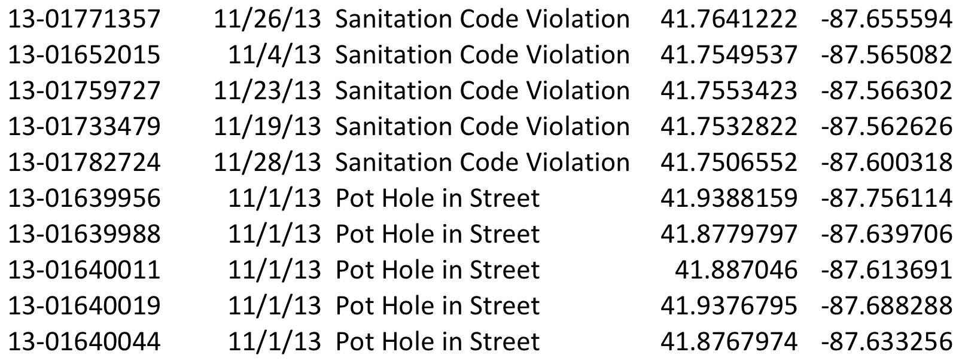
The 311 Dataset
311 is for non-emergency services.
Improved customer service for city departments and governmental agencies
Service requests:
Graffiti Removal, Vacant and Abandoned Buildings, Pot Holes, etc.
ID, Date, Request service, Latitude, Longitude
311 City Services – http://www.cityofchicago.org/city/en/depts/311.html
Notes:
311 is a telephone number for non-emergency services.
The aim of this service is to assist city departments and governmental agencies deliver improved customer service

Slide 26
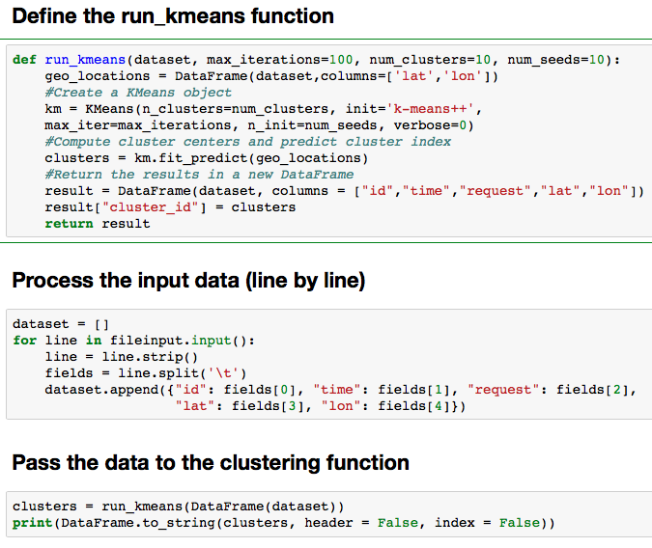
Python code to implement the K-Means clustering algorithm

Slide 27
Stream the data through a clustering algorithm using Pig streaming
define kmeans311 `/sw/anaconda/bin/python kmeans311.py` ship ('kmeans311.py');
raw = LOAD ’311_data.csv' USING PigStorage(',') AS (id:chararray,time:chararray,request:chararray,Lat:double,Lon:double);
step0 = FILTER raw BY time != 'null' AND time != '';
step1 = FILTER step0 BY $0 is not null;
step2 = FILTER step1 BY $1 is not null;
step3 = FILTER step2 BY $2 is not null and $2 MATCHES 'Alley Light Out’;
step4 = FOREACH step3 GENERATE $0,$1,$2,$3,$4;
result = stream step4 through kmeans311;
store result into 'kmeans_output';
Notes:
Ship is similar to –file in hadoop streaming api

Slide 28
K-Means Clustering
Step 1: Put the data in HDFS
$hdfs dfs -copyFromLocal 311_data.csv
Step 2: Run the Pig Script
$pig kmeans311.pig
Verify the output files were created in the kmeans_output folder in HDFS
$hdfs dfs -ls kmeans_output
Takes a source directory files as input and concatenates files in src into the destination local file.
$hdfs dfs -getmerge kmeans_output kmeans.csv

Slide 29
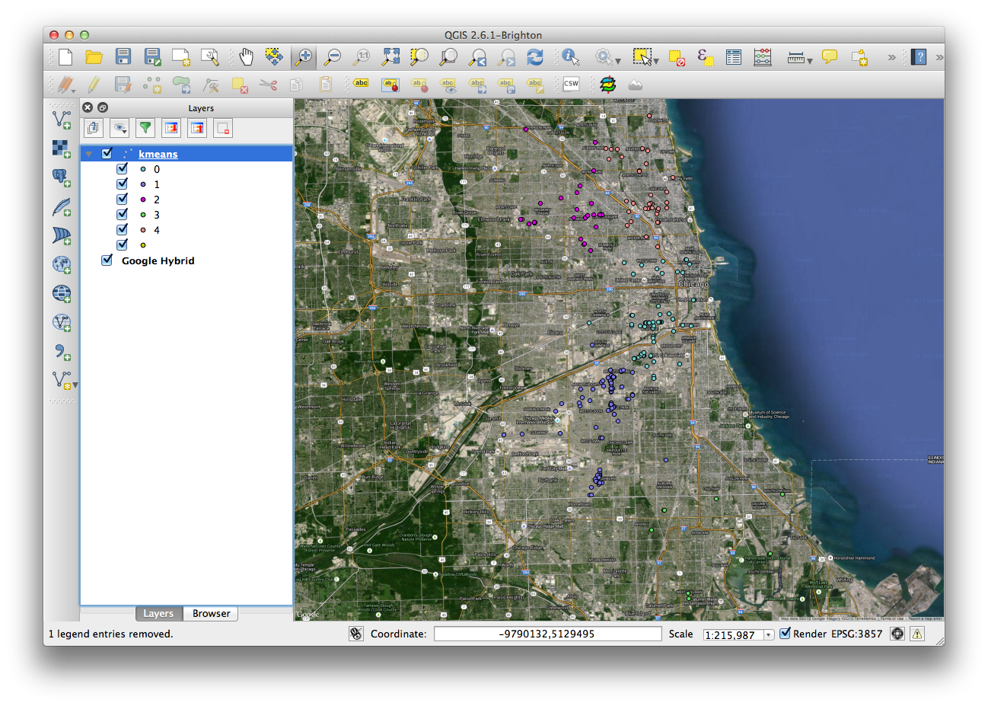
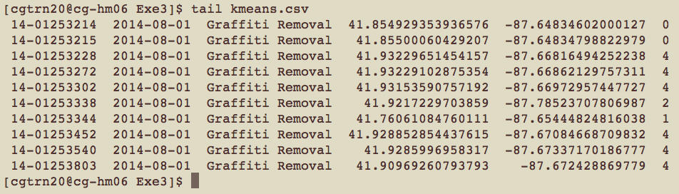
Exercise 3: K-Means Clustering
Step 4: View the result
$tail kmeans.csv
K-Means clustering for Graffiti removal requests from 01/15/2015 to 08/01/2014.

Slide 30
Quiz
A Python UDF must specify the Pig return type using the ( ) annotation.
True or False: The Pig stream command is enclosed in back ticks, not single quotes.
What does the “k” represent in the K-Means clustering algorithm?
Notes:
Putting a file into HDFS involves the following steps:

Slide 31
To be continued …
Hadoop Streaming API with Python for Geospatial operations
Spatial aggregation
Point-in-Polygon
Nearest Neighbor Search
Spatial indexing
Notes:
Putting a file into HDFS involves the following steps:

